Slide 1

Notes:
[BRIEF INTRO]
If you’re new to Grantham, we’re currently in a sermon series on the core teachings of Jesus, which are found in what is known as the Sermon on the Mount in Matthew chapters 5-7.
The Sermon on the Mount has a rather sophisticated 3-part structure … [NEXT SLIDE]

Slide 2
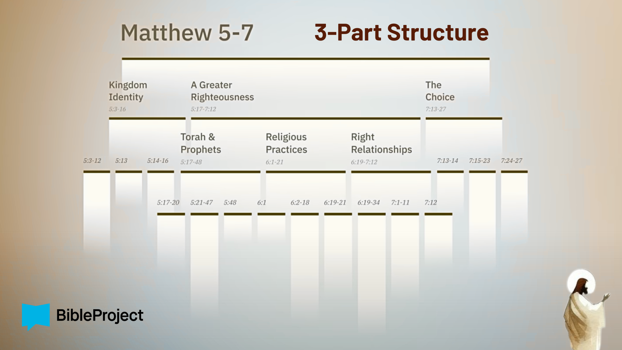
Notes:
Starting at the top of this image you can see that the Sermon on the Mount contains 3 major sections, the middle section (main body) itself has 3 parts, and each middle part breaks into 3 parts. And as most of you know, we began this series with the first two verses of “The Choice” that Jesus gives us in the conclusion. In Matt. 7:13-14, Jesus said there are two paths, a wide road to destruction and a narrow road to life. Therefore, we started with the end in mind so that we will be continually mindful of Jesus’ invitation to walk the narrow path.
In week two, we covered what we commonly call the Beatitudes, and what Jesus says is “the good life” for those who choose to follow him and enter his Kingdom. In week three, we concluded the opening of the sermon with Jesus’ call for his followers to be salt and light in the world—to push back on the darkness and decay of the world with the light of our witness; by embodying the good life of the Kingdom of God.
And then in week 4, Jesus began a new section and taught about “A Greater Righteousness” that fulfills the Torah (Law) and Prophets. He believed that the Hebrew Scriptures revealed how we are to live in right relationship with God, our neighbors, and our enemies. But Jesus also claimed that he was uniquely moving the story forward to its divinely intended goal and purpose. We are still looking at the section on the “Torah & Prophets” this morning.
Again, remember what Jesus said in Matthew 5:17 and 20… [NEXT SLIDE]

Slide 3
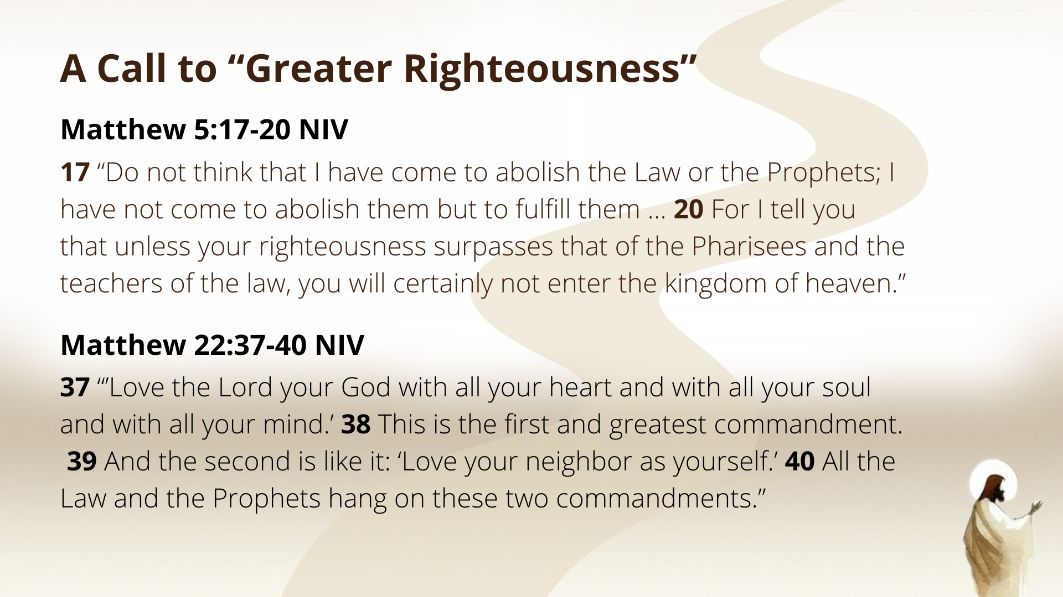
Notes:
[READ & COMMENT ON SCRIPTURE]
v. 17 – The law is the blueprint, but Jesus is the building
Matt. 22:37-40 – Jesus reveals how he interprets the Hebrew Scriptures
And so, as the definitive interpreter of Scripture, and rooting everything in love of God and neighbor, Jesus shows us how he interprets the Law with six case studies in Matthew 5:21-48. We’ve already heard Jesus address the commandment, “Do not murder” (Ex. 20:13) in week 5, and then the commandment, “Do not commit adultery” (Ex. 20:14) last week.
With each of his interpretations, we see that Jesus goes beyond external obedience to commandments to the deeper issues of the human heart. Jesus is dealing with our inner desires and motivations that affect how we treat people. With murder… he calls us to check our anger and rid ourself of hateful thoughts and speech. With adultery (last week), we heard Jesus’ invitation to guard our minds against lust and objectifying others. Which brings us to the third matter of the Law, where Jesus addresses a heavily debated topic in his day: divorce. If you’re taking notes, I’ve entitled this message… [NEXT SLIDE]

Slide 4

Notes:
Divorce, Remarriage, and God’s Grace.
But before we begin with our main Scripture reading for today, let’s watch this short movie clip from the 2005 film, Walk the Line… [NEXT SLIDE]

Slide 5
Notes:
[PLAY VIDEO CLIP – WALK THE LINE DIVORCE SCENE]
First, please don’t ever do anything like this to someone
Many of us can remember a time when those who had been divorced were looked down upon and treated as second class citizens
Has the church’s view of marriage and divorce changed in recent decades?
In some ways, we’ve succumbed to culture’s practice of “easy divorce”
But mostly, we (I think) have learned to extend grace
In 2025, roughly 41% of first marriages in the U.S. are estimated to end in divorce. The divorce rate for second marriages is much higher, at an estimated 60% to 67%. Third marriages have the highest divorce rate, with estimates as high as 70% to 73%. Several other factors have been shown to correlate with divorce rates: Marrying at a younger age is associated with a higher likelihood of divorce. Those with higher levels of education, particularly a bachelor's degree or higher, have lower divorce rates. Lower-income couples face higher rates of divorce, while higher income generally correlates with more stable marriages. Of course, divorce affects everyone, regardless of socio-economic status.
And so, it shouldn’t surprise us that Jesus addresses this… [NEXT SLIDE]

Slide 6

Notes:
…in the Sermon on the Mount. And as we will see today, divorce was not only all-too-common in the ancient world, but there was quite a debate going on about it within Judaism in the first century. So, let’s begin by reading Jesus’ teaching in Matthew 5:31.
[READ MATTHEW 5:31 & COMMENT]
Let’s stop there and talk about the context. As I said last week, in Jesus’ day, only Jewish men could initiate a divorce. And that imbalance led to all kinds of problems. Divorce was allowed, but only one law in the entire Torah addressed the issue (how to do it properly and for a legitimate reason), and Jesus just quoted from it in Deut. 24.
Let’s look at that together… [NEXT SLIDE]

Slide 7
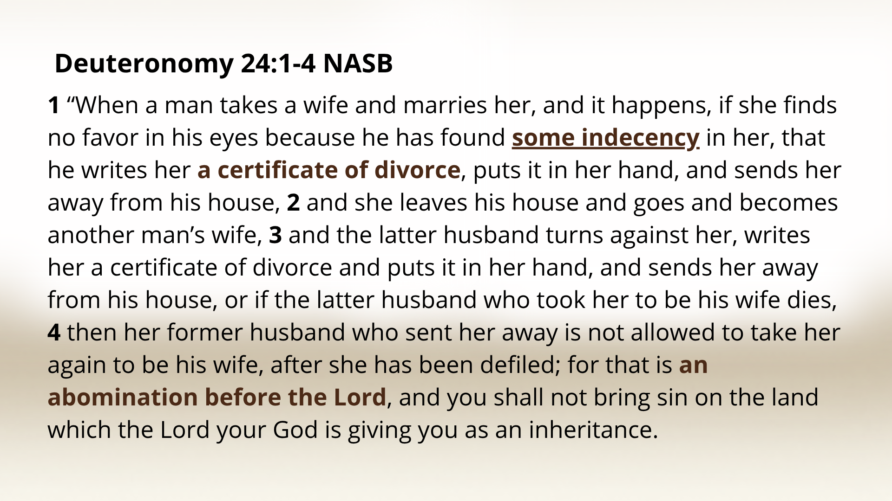
Notes:
[READ & COMMENT ON PASSAGE]
So, the law in Deut. 24:1 allows a man to divorce his wife if he’s found “some indecency” or “something offensive” in her. The Hebrew phrase is ervat davar, which literally means the “nakedness of a matter.” Well, what in the world does “nakedness of a matter” even mean?
And that was what was being debated in Jesus’ day. I’ve shown you this next slide before, last fall during the Jesus, Justice & the Third Way series… [NEXT SLIDE]

Slide 8
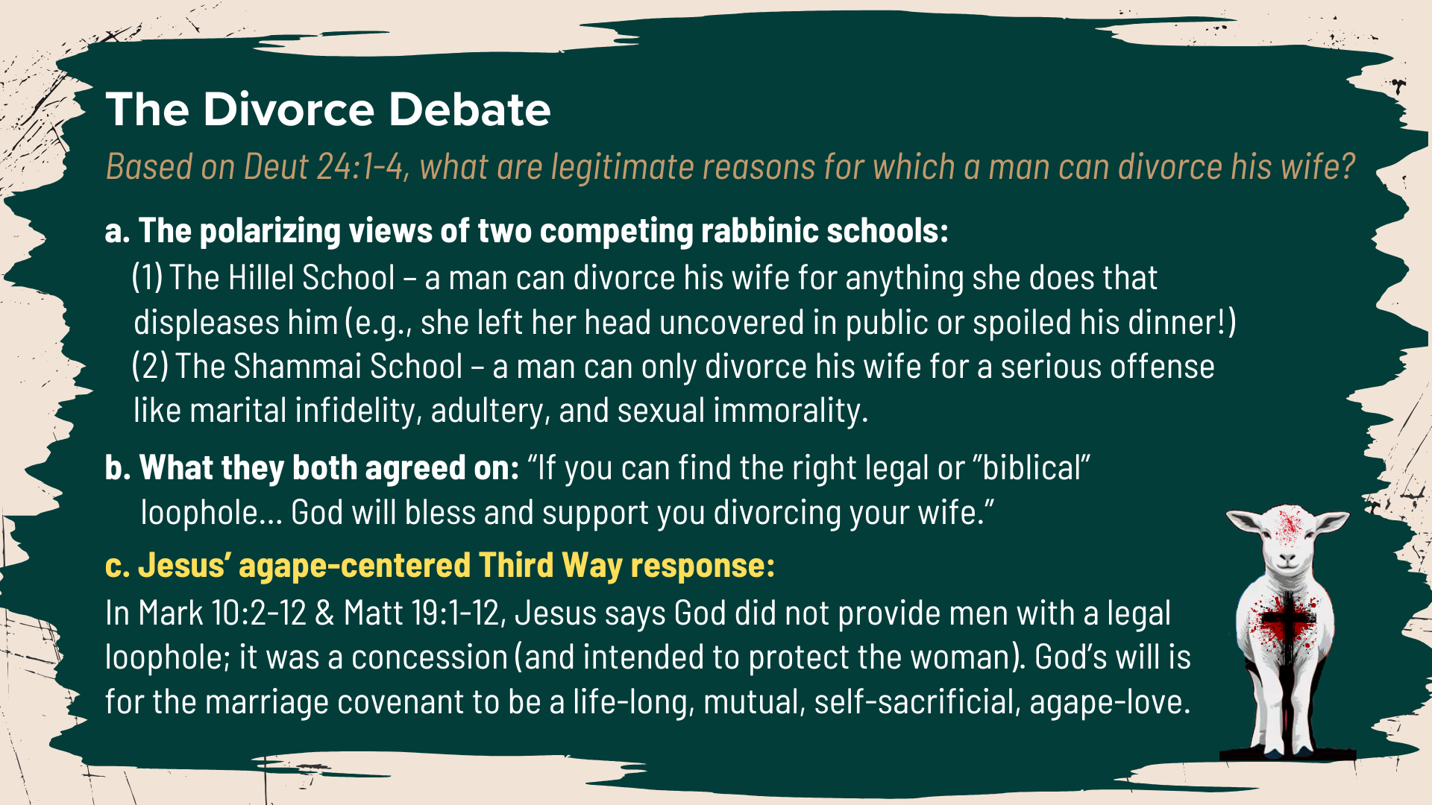
Notes:
[READ & COMMENT ON SLIDE]
Think about it… if a man could threaten divorce for any reason, that would lead to women being oppressed, vulnerable, and even abused. This is how some women ended up on the streets as prostitutes in Jesus’ day. If they didn’t have families to return to, they were left in a vulnerable position. So, to protect women, Jesus sided with those who limited legitimate divorce to cases of adultery. But he’s not going to simply take that position to “side” with someone in a debate, or for the letter of the law, but because of love of God and neighbor.
And he makes this clear when he says this in Matt. 5, verse 32: “But I tell you that anyone who divorces his wife, except for sexual immorality (porneia), makes her the victim of adultery, and anyone who marries a divorced woman commits adultery.”
What does it mean for a man to “make her the victim of adultery”? Well, once again, Jesus is being intentionally provocative, saying that if a man divorces his wife for an illegitimate reason—because he’s tired of the marriage or just wants to be with somebody else—his marriage covenant, in the eyes of God, still exists. And that means that any new marriage is an act of adultery. And notice, Jesus explicitly assigns blame to the men in his culture because it’s their selfish choices that are forcing women into these vulnerable situations.
You can see how this could play out in a society where only men can initiate divorce for any reason. This could normalize the oppression of women on a large scale. Not to mention what this sort of rampant “easy divorce” culture does to children. So, in his cultural context, Jesus’ statement protects and elevates the dignity of women as images of God.
And we get more of the context in Matthew chapter 19… [NEXT SLIDE]

Slide 9

Notes:
[READ MATT. 19:3-9 & COMMENT]
Our friends at the BibleProject say that Jesus is essentially saying this: “Men, stop harming women by marrying and divorcing flippantly, thinking it’s all good as long as it’s legal. You might think divorce is a convenient way to clear the slate and start fresh, but that’s not possible. It’s brutal, painful, and like radiation treatment [for cancer], only to be used in dire situations.”
But you may be wondering, what about other ways a marriage covenant can be violated, like neglect or abuse? Would those be legitimate reasons for divorce? Church, these are really important questions that Jesus, frankly, doesn’t address. His focus here is on how this one debated divorce law in the Torah was being twisted and misused by the men of his day. His aim is to protect women who are being used and abused, and he is declaring that life in God’s Kingdom protects the vulnerable and ensures just treatment for all.
And for Jesus, the marriage covenant is designed to create interdependence and mutual respect so that the two can reflect God’s image together as one flesh. And so, these things should be navigated prayerfully, seeking pastoral wisdom, advice, counseling, and always seeing divorce as the last resort after all attempts have been made to reconcile. Because severing “one flesh” back into two is painful, harmful to the soul and to all involved.
So, to sum up Matthew 19:1-12, we’re saying that… [NEXT SLIDE]

Slide 10
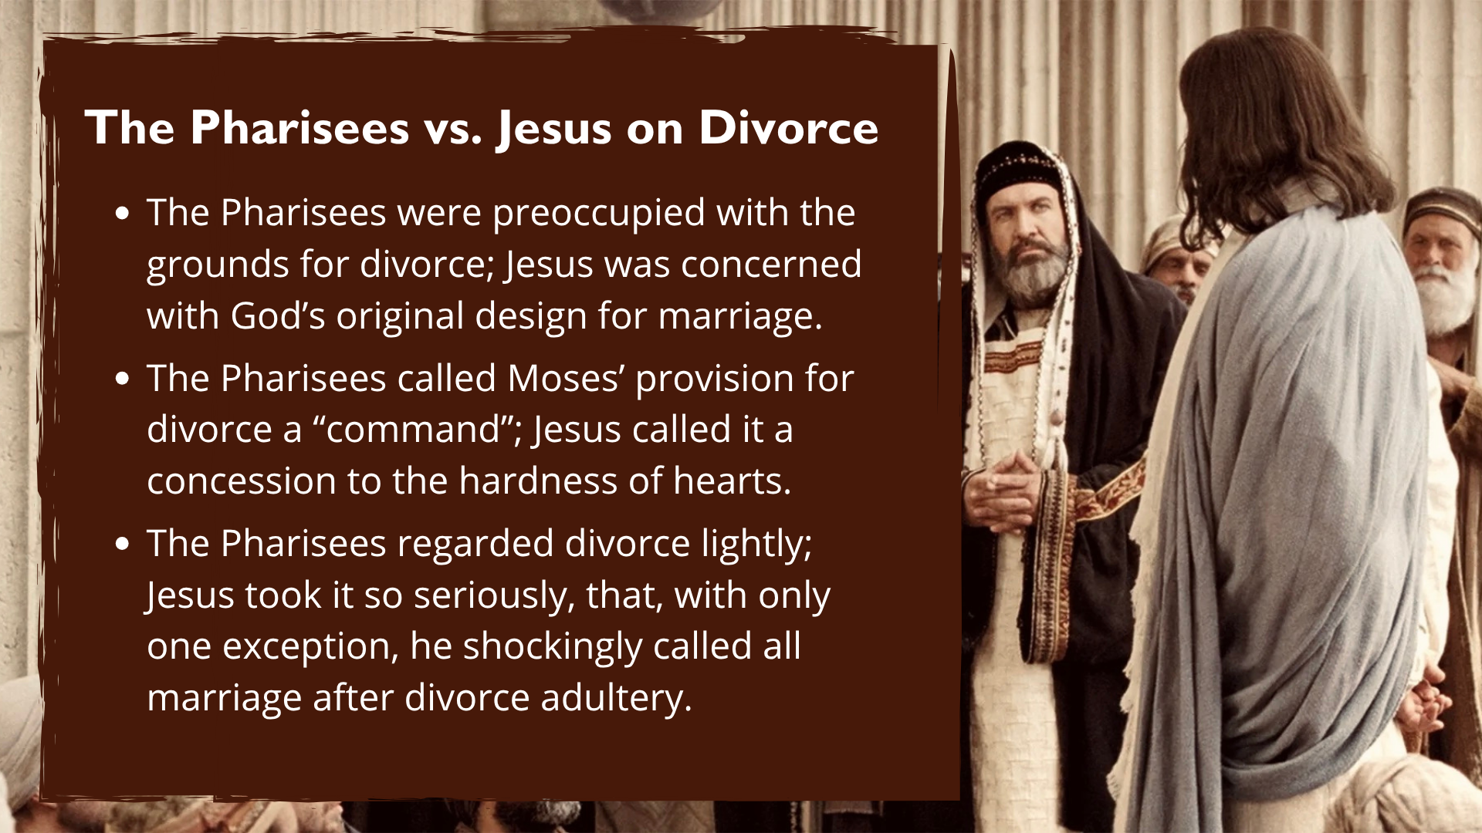
Notes:
READ SLIDE & COMMENT:
In Genesis, we see that marriage was intended as a sacred symbol of God’s love and covenant faithfulness (e.g., Hosea; Malachi 2:16 – “Yahweh hates divorce”)
Because the world is broken, men and women do selfish things, and some seriously violate their marriage vows through infidelity and abuse, and so divorce is allowed in order to prevent further harm and to protect the most vulnerable; but again, it’s a concession
We simply can’t get around it; Jesus doubles-down on the permanence of marriage, and he wants us to consider its sacredness and the lasting effects of divorce.
Therefore, Jesus was not brushing aside Deuteronomy 24:1, but rather he is revealing that God’s perfect will is one thing, but keep in mind that we live in a broken world, and we all need to examine the motives of our heart. You see, the Pharisees think Jesus is contradicting the law of Moses, but instead, he reveals something they missed. And so, look in the mirror. Are you honoring the biblical ideal for marriage or are you making it about you?
And then listen to the response of Jesus’ disciples. [READ MATT. 19:10-12 & COMMENT]
Here are some takeaways from today’s message… [NEXT SLIDE]

Slide 11


Slide 12


Slide 13


Slide 14


Slide 15


Slide 16

Notes:
Jesus restores God’s original design for marriage. Marriage is not a human contract, but a divine covenant rooted in creation—listen to what Jesus said, “what God has joined together...” Jesus calls his followers back to this vision of lifelong faithfulness and mutual love.
Divorce is a concession to human hardness of heart, not God’s ideal. Jesus acknowledges that divorce exists because of sin and brokenness, but he makes clear that it was never God’s intention. It represents a fracture in what God designed to be whole. And so, faithful, life-long marriage is possible with Christ at the center of it.
Unfaithfulness is a serious violation of the marriage covenant. Jesus allows for sexual immorality (“porneia”) as an exception in Matthew’s Gospel, recognizing it as a betrayal of the one-flesh union. Yet even in this, Jesus’ tone is one of sorrow and realism, not permission or encouragement. Nobody wins in divorce.
Kingdom righteousness calls for heart-level faithfulness. True obedience is not found in legal loopholes but in covenantal integrity. And so, Jesus transforms marriage from a contract to a covenant; from a legal arrangement into a reflection of God’s faithful love, calling disciples to purity, forgiveness, and compassion.
The church must hold truth and grace together. Brothers and sisters, disciples are called to uphold Jesus’ high view of marriage while extending mercy, grace, and healing to those wounded by divorce. The goal is not condemnation but restoration—to reflect the redemptive love of Christ in community (e.g., John 4 – The Samaritan Woman at the Well – married 5 times, yet loved by Jesus).
Finally, here are some questions to help us reflect and respond… [NEXT SLIDE]

Slide 17


Slide 18


Slide 19


Slide 20

Notes:
[READ & BRIEF COMMENT ON EACH QUESTION]
How does Jesus’ vision of marriage and his thoughts on divorce challenge my own view of commitment, love, and covenant? Am I treating marriage (or any relationship) as a contract of convenience or as a covenant of faithfulness rooted in God’s love?
Where might “hardness of heart” be keeping me from forgiveness, reconciliation, or healing—either in marriage or in my relationships? How might Jesus be inviting me to move toward humility, mercy, and grace instead of defensiveness or resentment?
How can the church embody both truth and grace toward those who have experienced divorce? How can I show God’s grace to them? Am I willing to walk with others in their pain, without judgment, while also upholding the beauty of Jesus’ kingdom vision for marriage? And am I willing to receive God’s grace for myself?
[CLOSING WORDS]
Let’s pray… [NEXT SLIDE FOR CLOSING PRAYER]

Slide 21

Notes:
[CLOSING PRAYER]
[CLOSING SONG]
Benediction
Brothers and sisters, you have heard the words of Jesus and the call to follow him. The path is narrow, but it leads to life. Remember that Christ walks with you, the Father surrounds you, and the Spirit empowers you. Therefore, go in peace, to love and serve the Lord. Amen.

